Slide 1
Air Travel Safety
Michael Loos

Slide 2
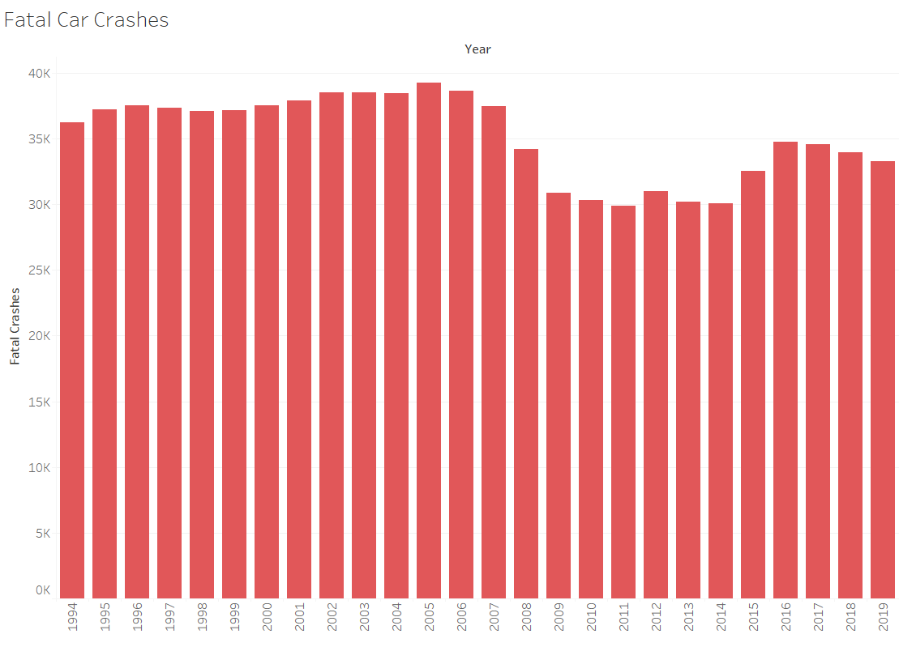
Is Car Travel Becoming More Dangerous?
While the media focuses on the danger of air travel, fatal car crashes have been at their highest in years

Slide 3
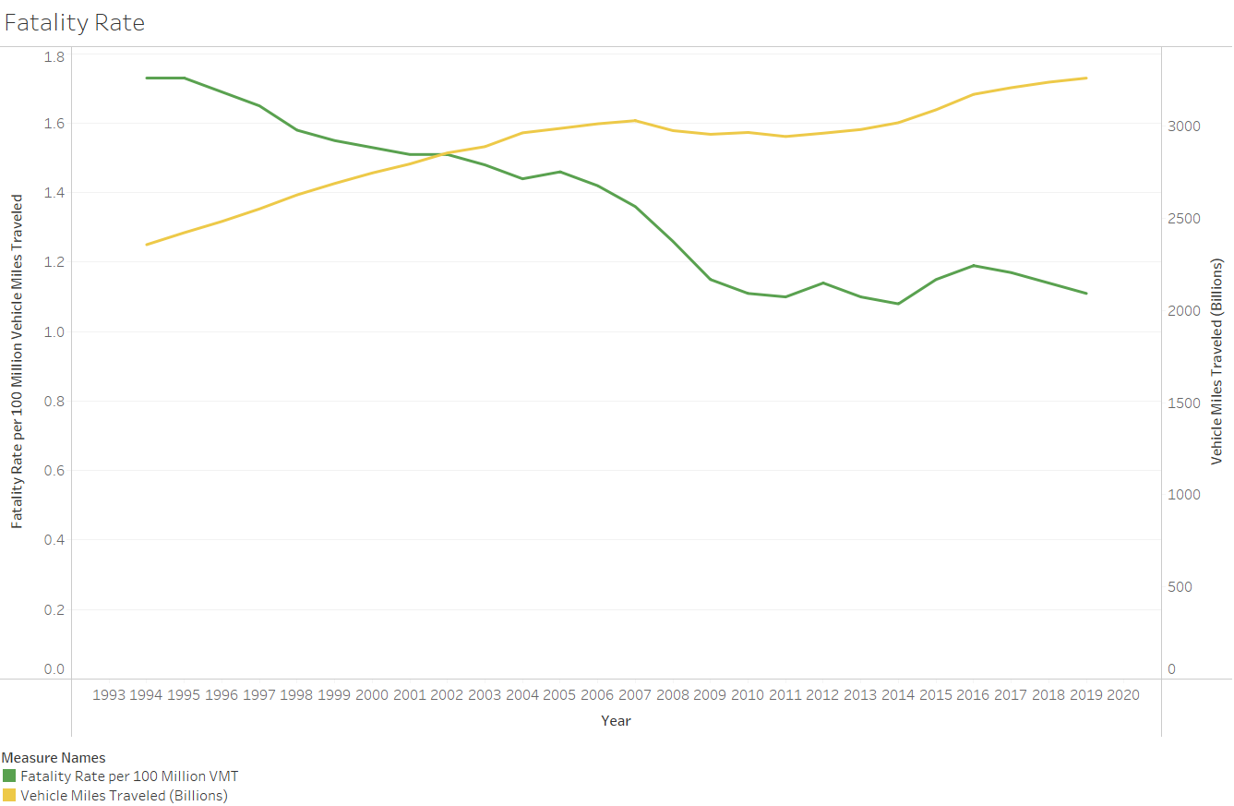
Lies, Damn Lies, and Statistics
In reality, travel has increased while fatality rate has decreased
The same misinformation is being spread about air travel

Slide 4
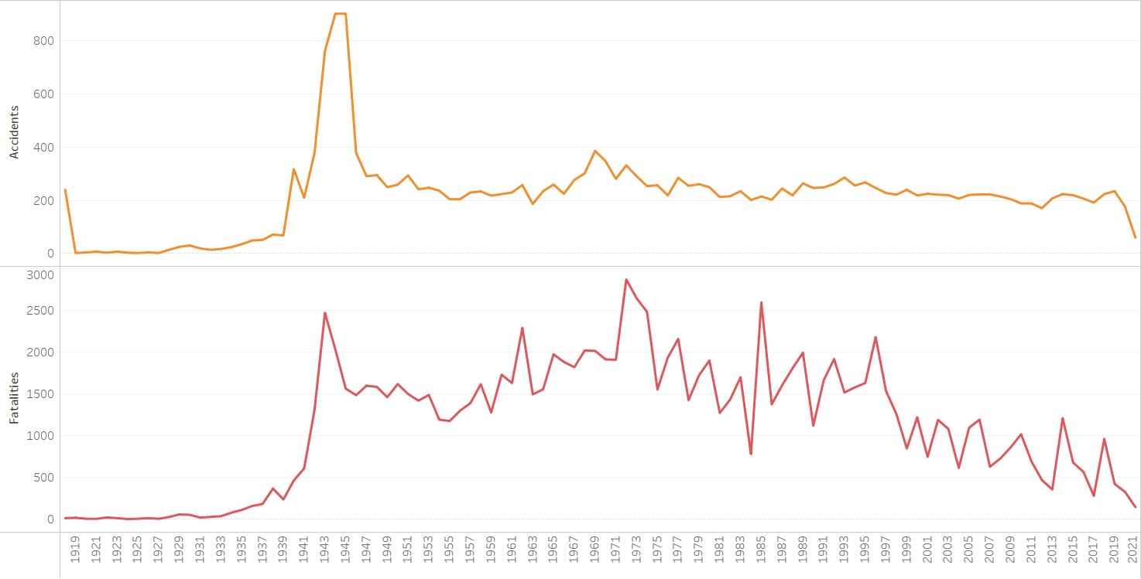
Incidents in Air Travel are Decreasing
Accidents and Fatalities continue downward trend

Slide 5
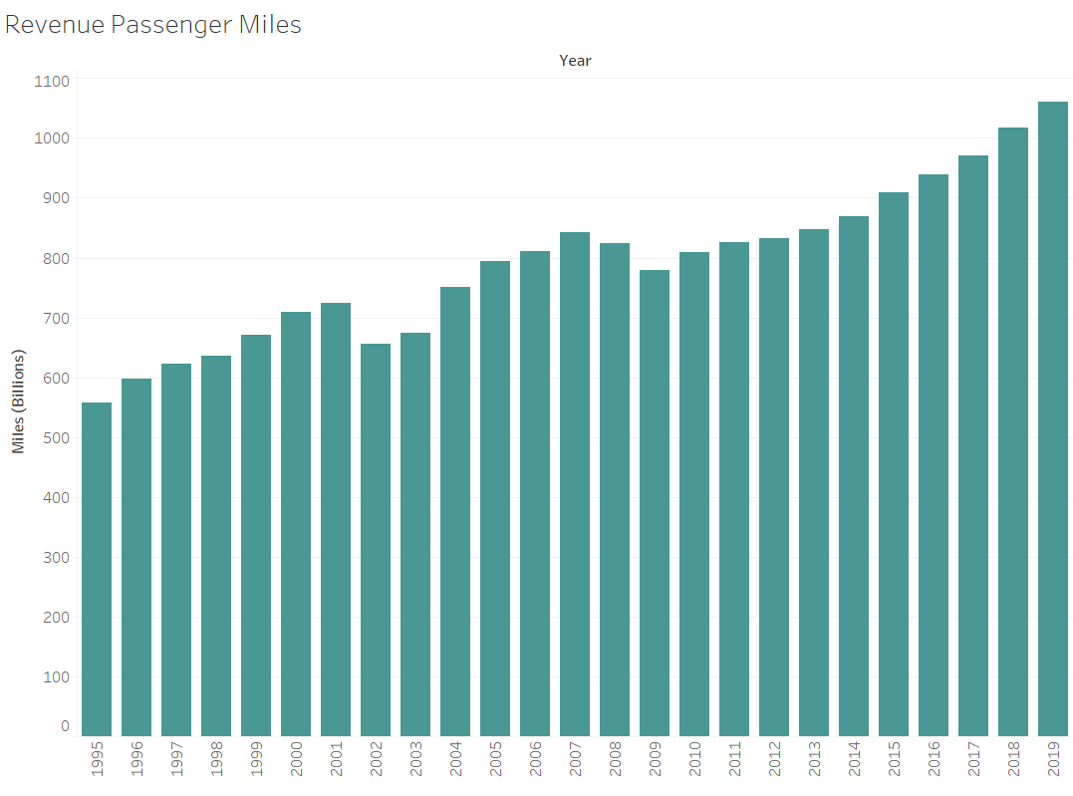
Customers Show Confidence
Customers continue upward trend in air travel
Increase in passenger miles each of the last ten years

Slide 6
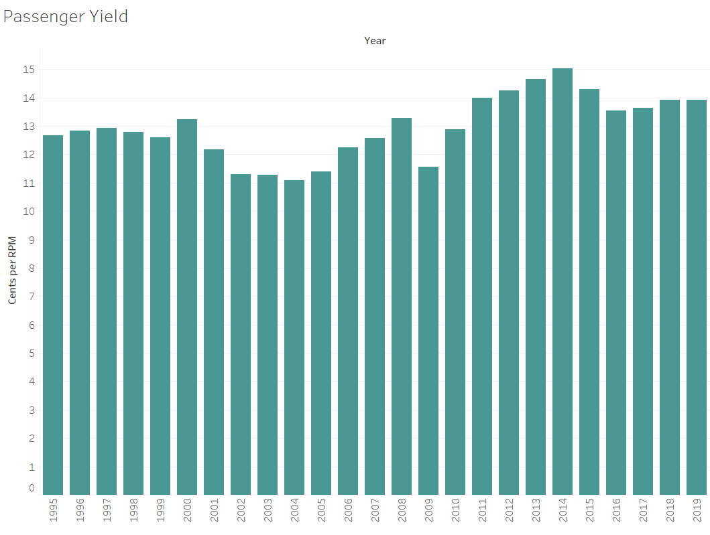
Revenue Remains Strong
Profitability per customer in 2010s outperforming previous decade

Slide 7
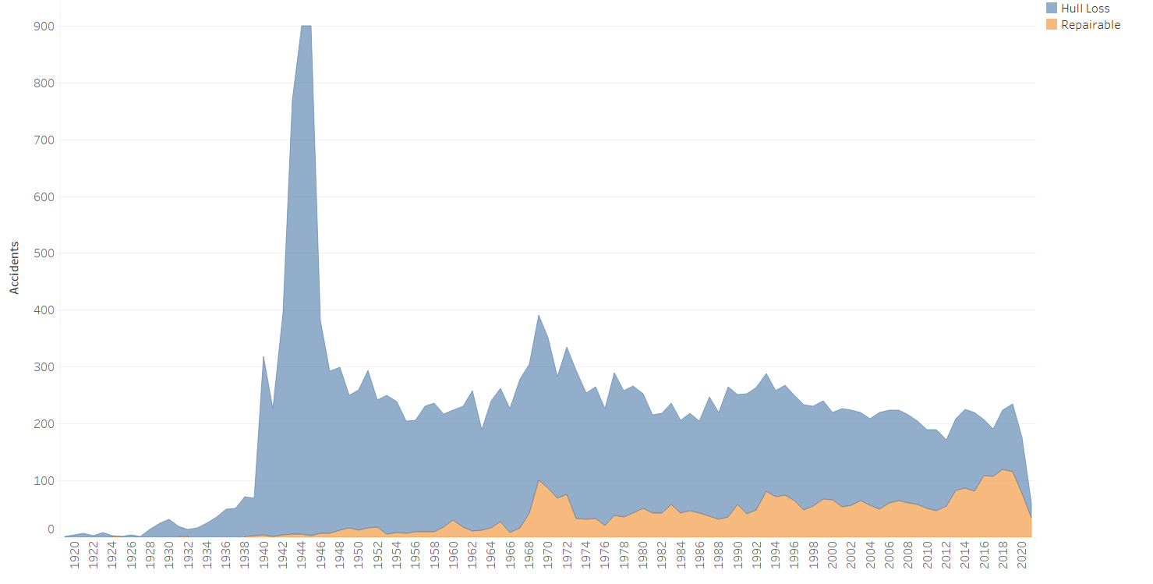
Less Severe Accidents, Less Severe Damage
As accidents decrease, they also tend to be more minor
This decrease leads to reduced repair costs

Slide 8
Conclusion
Air travel is safer than ever
Customers show they share this belief with increased travel
Revenue remains strong
Increased safety is reducing costs

